Slide 1
BIG DATA [MODULE 2]
Cloud computing

Slide 2

whoami
Matteo Francia
Email: m.francia@unibo.it
Research fellow @ UniBO
Research topics
Big data / database
Geo-spatial analytics
Thesis proposals
https://big.csr.unibo.it/teaching/
https://big.csr.unibo.it/

Slide 3
Exam
We will see how (big) data pipelines can be done in the cloud
We will cover some "theory" as well as get our hands dirty
This module is part of the oral examination
(If agreed) The project can be extended to the cloud to get more points
E.g., rethink a part of the project on cloud

Slide 4
Roadmap
Introduction to cloud and cloud service providers
Cloud services (in AWS)
Hands-on cloud services
Orchestrating (small) data pipelines
Migrating a cluster to the cloud
Migration pricing

Slide 5
Set up
You (will) have an AWS Educate account
A coupon of 150$ to test AWS cloud services
The content of these slides refers to this repo
https://github.com/w4bo/bigdata-aws/
Options
Work on your pc: check the `README.md` to install the necessary software tools
Mainly: git, IntelliJ IDEA (Community Edition), docker, AWS CLI, AWS SAM CLI
Download a pre-configured (VMware) VM with the installed software
https://aws.amazon.com/education/awseducate/

Slide 6
Set up
Download a pre-configured (VMware) VM with the installed software
Connect to a PC-lab using Guacamole (click here https://csi-rlab.campusfc.unibo.it/)
Enter your credentials
Choose `LabCEZ`
Click on the proper lab
Once logged in, download the VM from http://big.csr.unibo.it/downloads/ubuntu-64-bit.zip
Unzip the content and launch `VMware Workstation Pro` (from the desktop)
`File` > `Open...` > `path/to/the/unzipped/vm/*.vmx` file
Launch the VM (user: `bigdata`, pwd: `bigdata`)

Slide 7
So far
You have practiced with on-premises solutions
You were given a working hardware cluster
... to deploy software applications on Hadoop-based stack
Let us guess, how would you start from scratch?
How would you do that?
How much time would it take?

Slide 8
So far
No easy answers
Big-data (distributed) architectures require a lot of skills
Installation: how do I set up a new machine?
Networking: how do I cable dozens of machines?
Management: how do I replace a broken disk?
Upgrade: how do I extend the cluster with new services/machines?
(energy and cooling, software licenses, insurance...)
https://aws.amazon.com/compliance/data-center/data-centers/

Slide 9
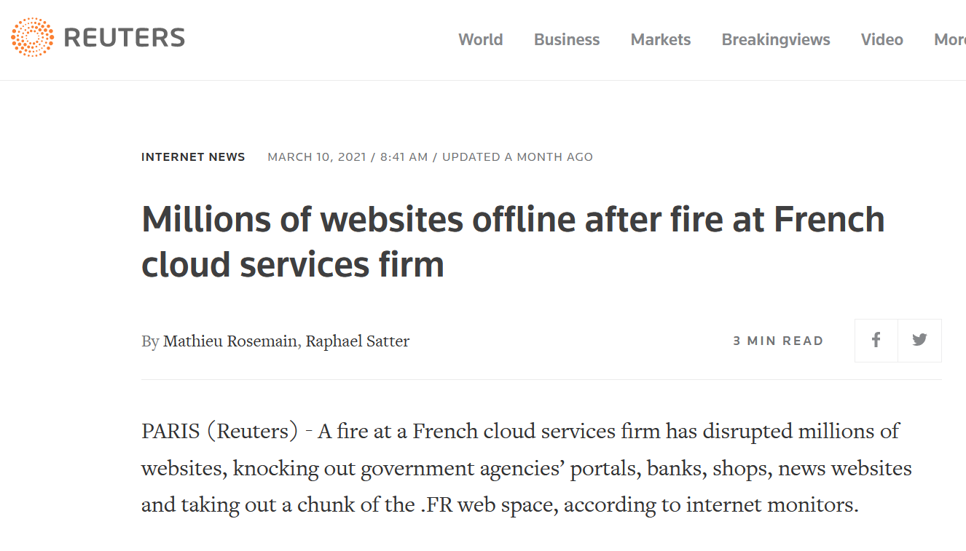
So far
https://www.reuters.com/article/us-france-ovh-fire-idUSKBN2B20NU

Slide 10
So far
Technological perspective
How do we configure a distributed environment?
How do we set up independent services?
How do we integrate such services?
How do control resource accesses (e.g., storage)?
How do we orchestrate data flows?
It depends on your (team) skills (not only software engineering)
Business perspective
No free lunch, each choice has cost/benefit
How much time does it take to master a technology?
How many people do I need?

Slide 11
So far
Can we afford to spend resources on tasks that are not mission oriented?
Mission: a statement used by a company to explain its purpose(s)
How can I build a working application/data platform?

Slide 12
BIG DATA
Why going cloud?

Slide 13
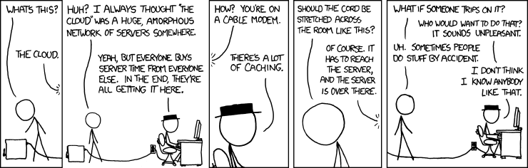
https://xkcd.com/908/

Slide 14
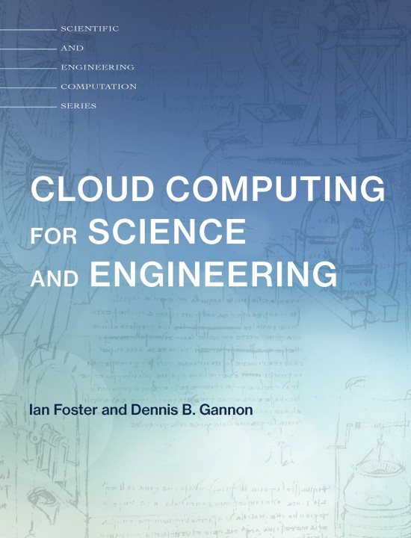
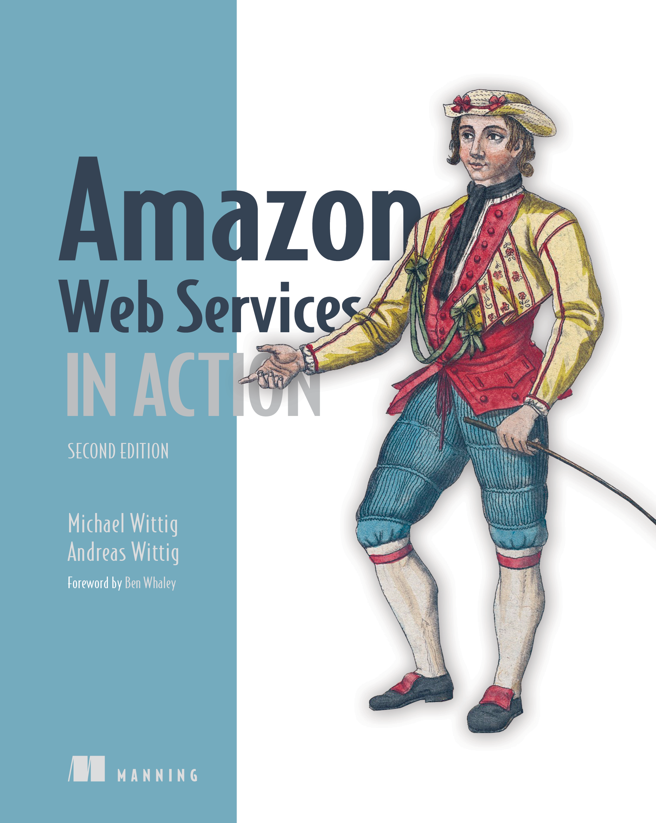
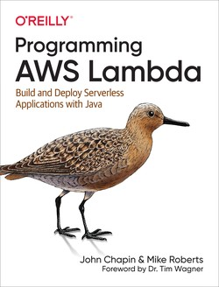
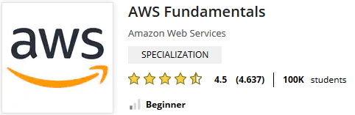
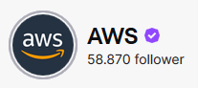
Teaching material
Books
Web content
Generic
Specific

Slide 15
Why going cloud?
Cloud computing (National Institute of Standards and Technology)
“A model for enabling ubiquitous, convenient, on-demand network access to a shared pool of configurable computing resources (e.g., networks, servers, storage, services) that can be rapidly provisioned and released with minimal management effort or service provider interaction.”
On-demand self-service (consume services when you want)
Broad network access (consume services from anywhere)
Resource pooling (infrastructure, virtual platforms, and applications)
Rapid elasticity (enable horizontal scalability)
Measured service (pay for the service you consume as you consume)

Slide 16
Why going cloud?
Goal: adjusts capacity to have predictable performance at the lowest cost
Scalability that is not possible on premises
Scale from one to thousands of servers
Elasticity
Automatically scale resources in response to run-time conditions
Core justification for the adoption of cloud

Slide 17
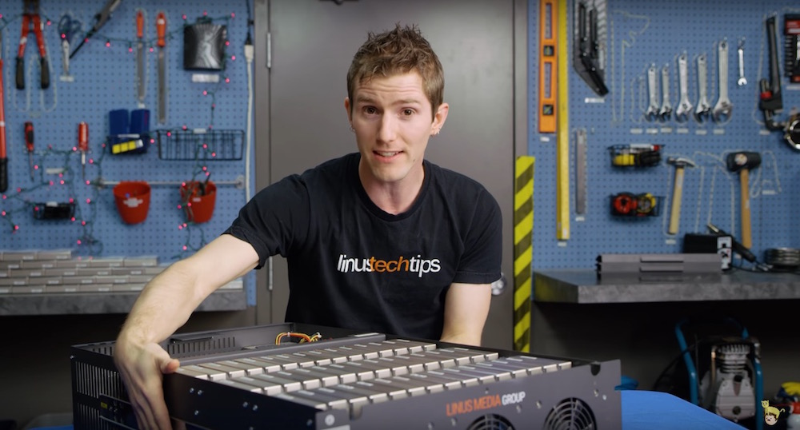
Why going cloud
Hardware scalability
No longer think about rack space, switches, and power supplies, etc.
Grow storage from GBs to PBs
One hundred of our 10TB Enterprise Capacity 3.5 HDD hard drives
https://blog.seagate.com/business/linus-tech-tips-want-petabyte-system/

Slide 18
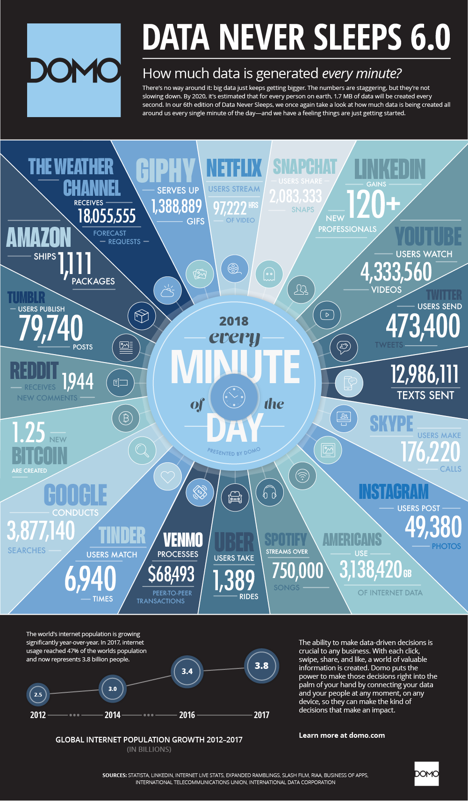
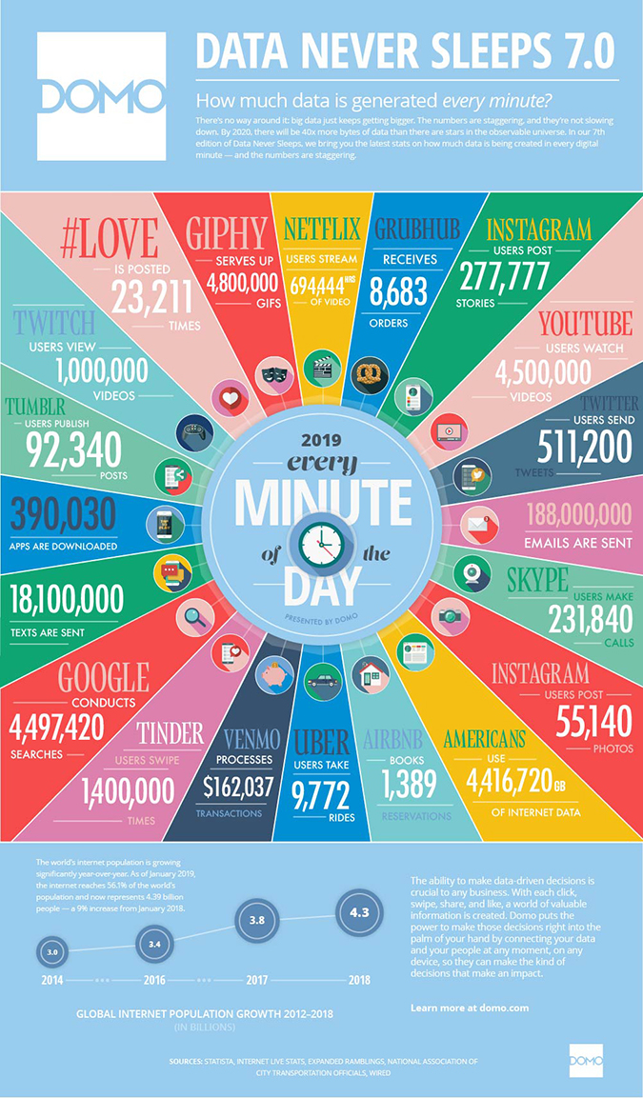
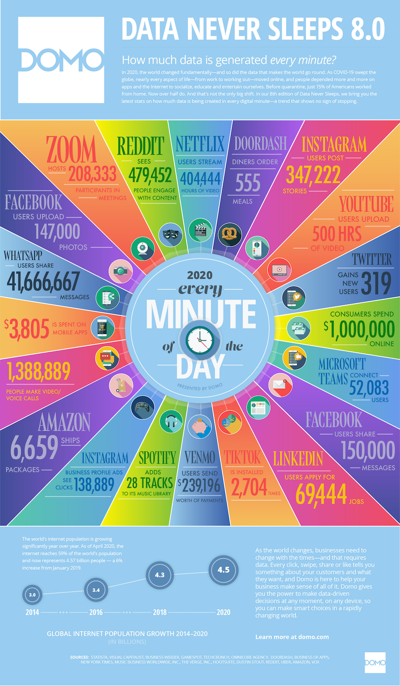
Why going cloud?
https://www.domo.com/learn/data-never-sleeps-8

Slide 19
Why going cloud?
Resource pooling
Enable a resource to serve different consumers
Dynamically reassigned according to demands
Economy of scale
Reliability
Built to handle failures
Fault-tolerant or highly available
Worldwide deployment
Deploy applications as close to customers as possible
E.g., to reduce network latency
Improve data locality
Compliant to privacy regulations (e.g., GDPR)

Slide 20
Why going cloud?
User perspective
Eliminate repetitive tasks to focus on strategic ones
Abstract the underlying architecture
Adapt infrastructure to requirements, create (test) environments on demand
Service integration
Do not reinvent the wheel
Use services that solve common problems (e.g., load balancing, queuing)
Service integration and abstraction are drivers of change
From databases to data platforms
From on-premises hardware to serverless architectures
From custom to standard data pipelines

Slide 21
BIG DATA
From databases to data platforms

Slide 22
Data platform
Companies are collecting tons of data to enable advanced analytics
Data are more and more heterogeneous and complex
Raw data are difficult to obtain, interpret, describe, and maintain
There is a need for describing/curating the data to make them consumable
Databases/warehouses are no longer ideal data hubs for integration/analysis
Getting value from data is not only a matter of storage
Need integrated and multilevel analytical skills and techniques

Slide 23
Data platform
Database
"A database is a structured and persistent collection of information about some aspect of the real world organized and stored in a way that facilitates efficient retrieval and modification. The structure of a database is determined by an abstract data model. Primarily, it is this structure that differentiates a database from a data file. The most popular data model is relational that represents data as a set of tables."
Data Warehouse
"A collection of data that supports decision-making processes. It provides the following features: subject-oriented, integrated and consistent, not volatile."
Özsu M.T. (2018) Database. In: Encyclopedia of Database Systems. Springer, New York, NY. https://doi.org/10.1007/978-1-4614-8265-9_80734 Matteo Golfarelli and Stefano Rizzi. Data warehouse design: Modern principles and methodologies. McGraw-Hill, Inc., 2009.

Slide 24
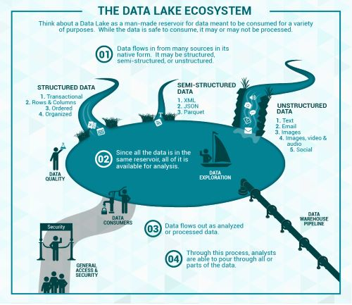
Data platform
Data lake
Couto et al.: “A DL is a central repository system for storage, processing, and analysis of raw data, in which the data is kept in its original format and is processed to be queried only when needed. It can store a varied amount of formats in big data ecosystems, from unstructured, semi-structured, to structured data sources”
Couto, Julia, et al. "A Mapping Study about Data Lakes: An Improved Definition and Possible Architectures." SEKE. 2019. https://dunnsolutions.com/business-analytics/big-data-analytics/data-lake-consulting

Slide 25
Data platform
Data lakes have increasingly taken the role of data hubs
Eliminate up-front costs of ingestion since data are stored in original format
Once in DL, data are available for analysis by everyone in the organization
Drawing a sharp line been storage/computation/analysis is hard
Is a database just storage?
What about SQL/OLAP?
Blurring of the architectural borderlines
DL is often replaced by “data platform” or “data ecosystem”
Encompass systems supporting data-intensive storage, computation, analysis

Slide 26
Data platform
Data platform (e.g., on Google Cloud and Amazon AWS)
Rationale: relieve users from complexity of administration and provision
Not only technological skills, but also privacy, access control, etc.
Only focus on functional aspects
Are we done? No!
Lacking smart support to govern the complexity of data and transformations
Data transformations must be governed to prevent DP turns into a swamp
Amplified in data science, with data scientists prevailing data architects
Leverage descriptive metadata and maintenance to keep control over data

Slide 27
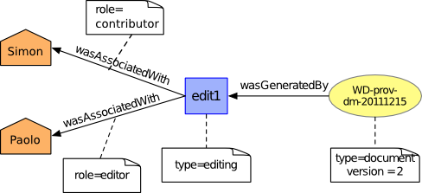
Data platform
Data provenance
Metadata pertaining to the history of a data item
Pipeline including the origin of objects and operations they are subjected to
We have a standard: https://www.w3.org/TR/prov-dm/
https://www.w3.org/TR/prov-dm/

Slide 28
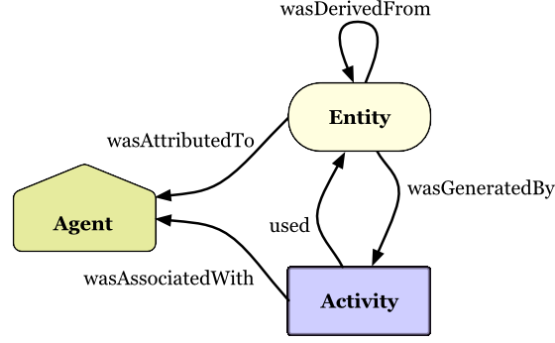
Data provenance
Entity
Physical/conceptual things
Activity
Dynamic aspects of the world, such as actions
How entities come into existence, often making use of previously existing entities
Agent
A person, a piece of software
Takes a role in an activity such that the agent can be assigned some degree of responsibility for the activity taking place
https://www.w3.org/TR/2013/NOTE-prov-primer-20130430/

Slide 29
Data provenance
Data quality
Monitoring of the quality (e.g., accuracy) of the objects produced
Notify when a transformation pipeline is not behaving as expected
Debugging
Inferring the cause of pipeline failures is challenging
Store inputs of each operation with versions and environmental settings (RAM, CPUs, etc.)
And so on...

Slide 30
Data platform
Are we done? No!
Metadata can become bigger than data themselves
We need meta meta-data (or models)...
... chasing our own tails
Data management is still a (research) issue in data platforms

Slide 31

Data platform
MOSES: making data platform smarter
Functional architecture
Components of MOSES are in orange
The others are standard components in charge of producing/consuming, processing, storing, and visualizing data
The orchestrator (e.g., Oozie in the Hadoop ecosystem) manages (e.g., schedules) the data transformation processes
O
r
c
h
e
s
t
r
a
t
o
r
/
W
o
r
k
f
l
o
w
M
a
n
a
g
e
r
S
o
u
r
c
e
s
&
D
e
s
t
i
n
a
t
i
o
n
s
S
o
u
r
c
e
1
M
O
S
E
D
S
a
t
a
P
r
o
c
e
s
s
e
s
M
e
t
a
d
a
t
a
E
x
t
r
a
c
t
o
P
r
r
o
c
.
1
P
r
o
c
.
2
…
P
r
o
c
.
S
m
o
u
r
c
e
2
M
e
t
a
d
a
t
a
S
e
a
r
c
P
h
u
s
h
&
P
u
l
l
E
n
g
i
n
D
e
a
t
a
F
l
o
w
s
P
r
o
v
e
n
a
n
c
…
e
…
M
a
n
a
g
e
r
T
r
i
g
g
e
r
E
n
g
i
n
e
S
Trigger Engine
t
o
r
a
g
D
e
e
s
t
.
n
O
t
h
e
r
O
t
h
e
r
C
o
m
p
o
n
e
n
t
D
s
F
S
S
t
o
r
a
g
e
s
M
e
t
a
d
a
t
a
P
r
o
c
e
s
s
I
n
t
e
r
f
a
c
e
s
M
O
S
E
S
I
n
t
e
r
f
a
c
e
W
s
e
b
O
t
h
e
r
W
o
r
k
f
l
o
w
M
e
t
a
d
a
t
a
G
U
I
I
n
t
e
r
f
a
c
e
I
n
t
e
r
f
a
c
e
s
A
d
m
i
n
i
s
t
r
a
t
i
o
n

Slide 32
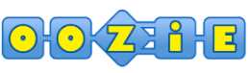



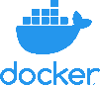

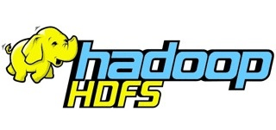
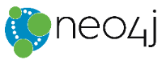

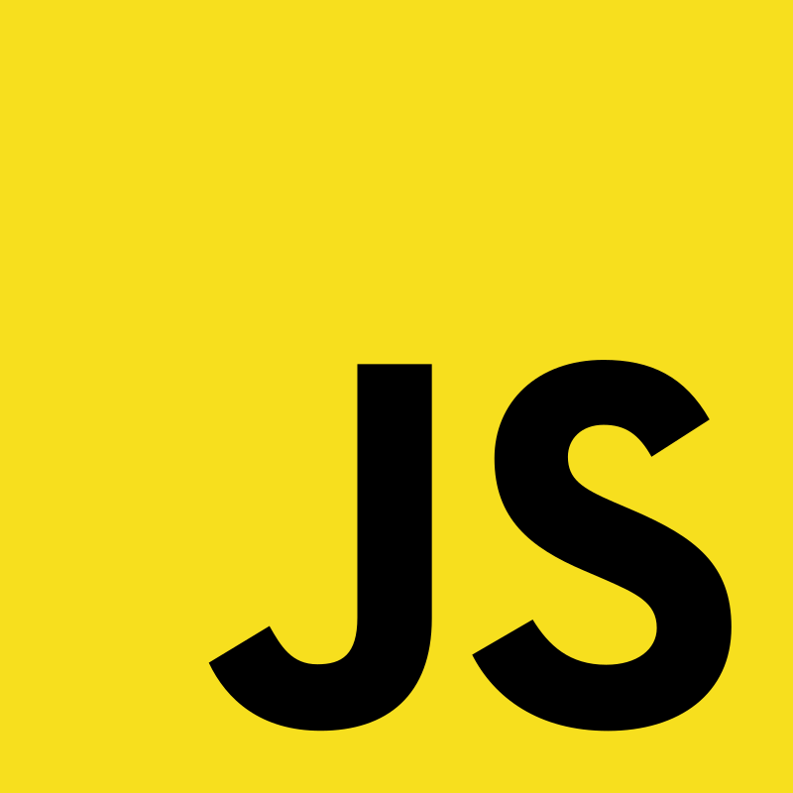
Data platform
MOSES is used within a DP that builds atop the Hadoop ecosystem
The cluster runs the Cloudera Distribution for Apache Hadoop 6.2.0 and Docker
The metadata collected and manipulated are stored in a graph database
The graph data model favors the modeling of highly interconnected data in the absence of fixed schemas
Service decoupling: functional components are accessible using RESTful APIs
Orchestrator
Data Processes
MOSES
Proc. 1
Proc. 2
…
Proc. m
Metadata Extractor
Metadata Search
Engine
Provenance Manager
Storage
Trigger Engine
Other Storages
DFS
Custom components
Metadata
Process Interfaces
MOSES Interfaces
Web Interface
Other Interfaces
Workflow Administration
Metadata GUI
Leoni Anna Giulia. "Gestione di un data lake strutturato attraverso il riconoscimento semantico dei dati acquisiti."

Slide 33
BIG DATA
From PaaS to FaaS (serverless)

Slide 34
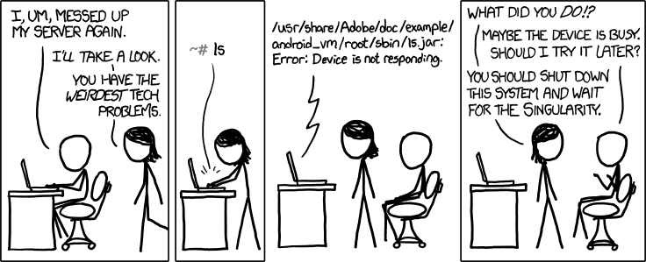
https://xkcd.com/1084/

Slide 35
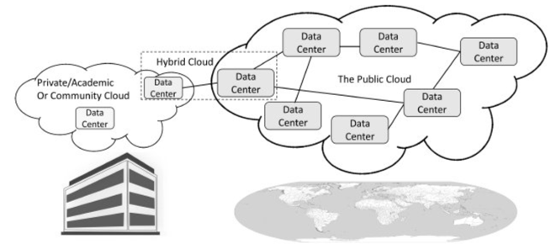
From PaaS to FaaS
Public: accessible to anyone willing to pay (e.g., Microsoft, AWS, Google)
Private: accessible by individuals within an institution
Hybrid: a mix of the previous

Slide 36
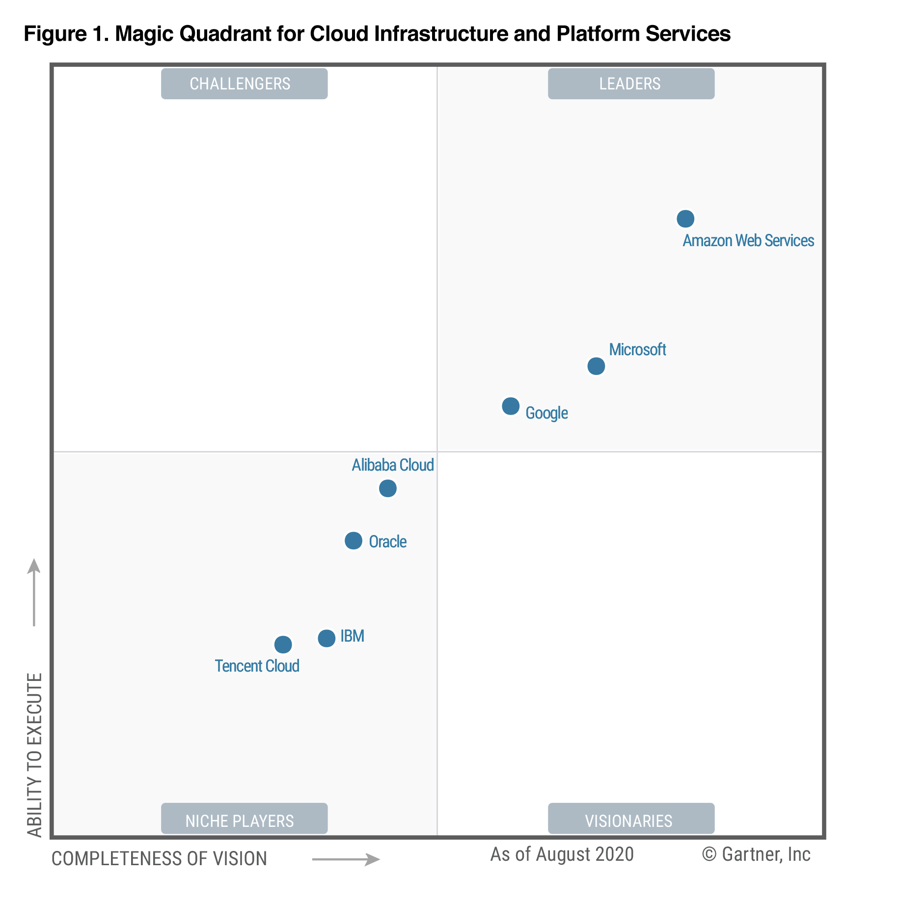
From PaaS to FaaS
Gartner Magic Quadrant
Understanding the technology providers to consider for an investment
Leaders execute well and are well positioned for tomorrow
Visionaries understand where the market is going but do not yet execute well
Niche Players focus successfully on a small segment, or are unfocused and do not out-innovate or outperform others
Challengers execute well but do not demonstrate an understanding of market direction
Focusing on leaders isn’t always the best
A niche player may support needs better than a market leader. It depends on how the provider aligns with business goals
https://www.gartner.com/en/research/methodologies/magic-quadrants-research

Slide 37
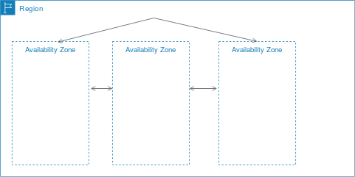
From PaaS to FaaS
Cloud services are hosted in multiple locations worldwide
Locations are composed of regions and availability zones
Region (e.g., us-east-1)
Is an independent geographical area
Has availability zones
Availability zones in a region
Are connected through low-latency links
Resources are usually replicated across zones but not regions
https://docs.aws.amazon.com/AWSEC2/latest/UserGuide/using-regions-availability-zones.html

Slide 38
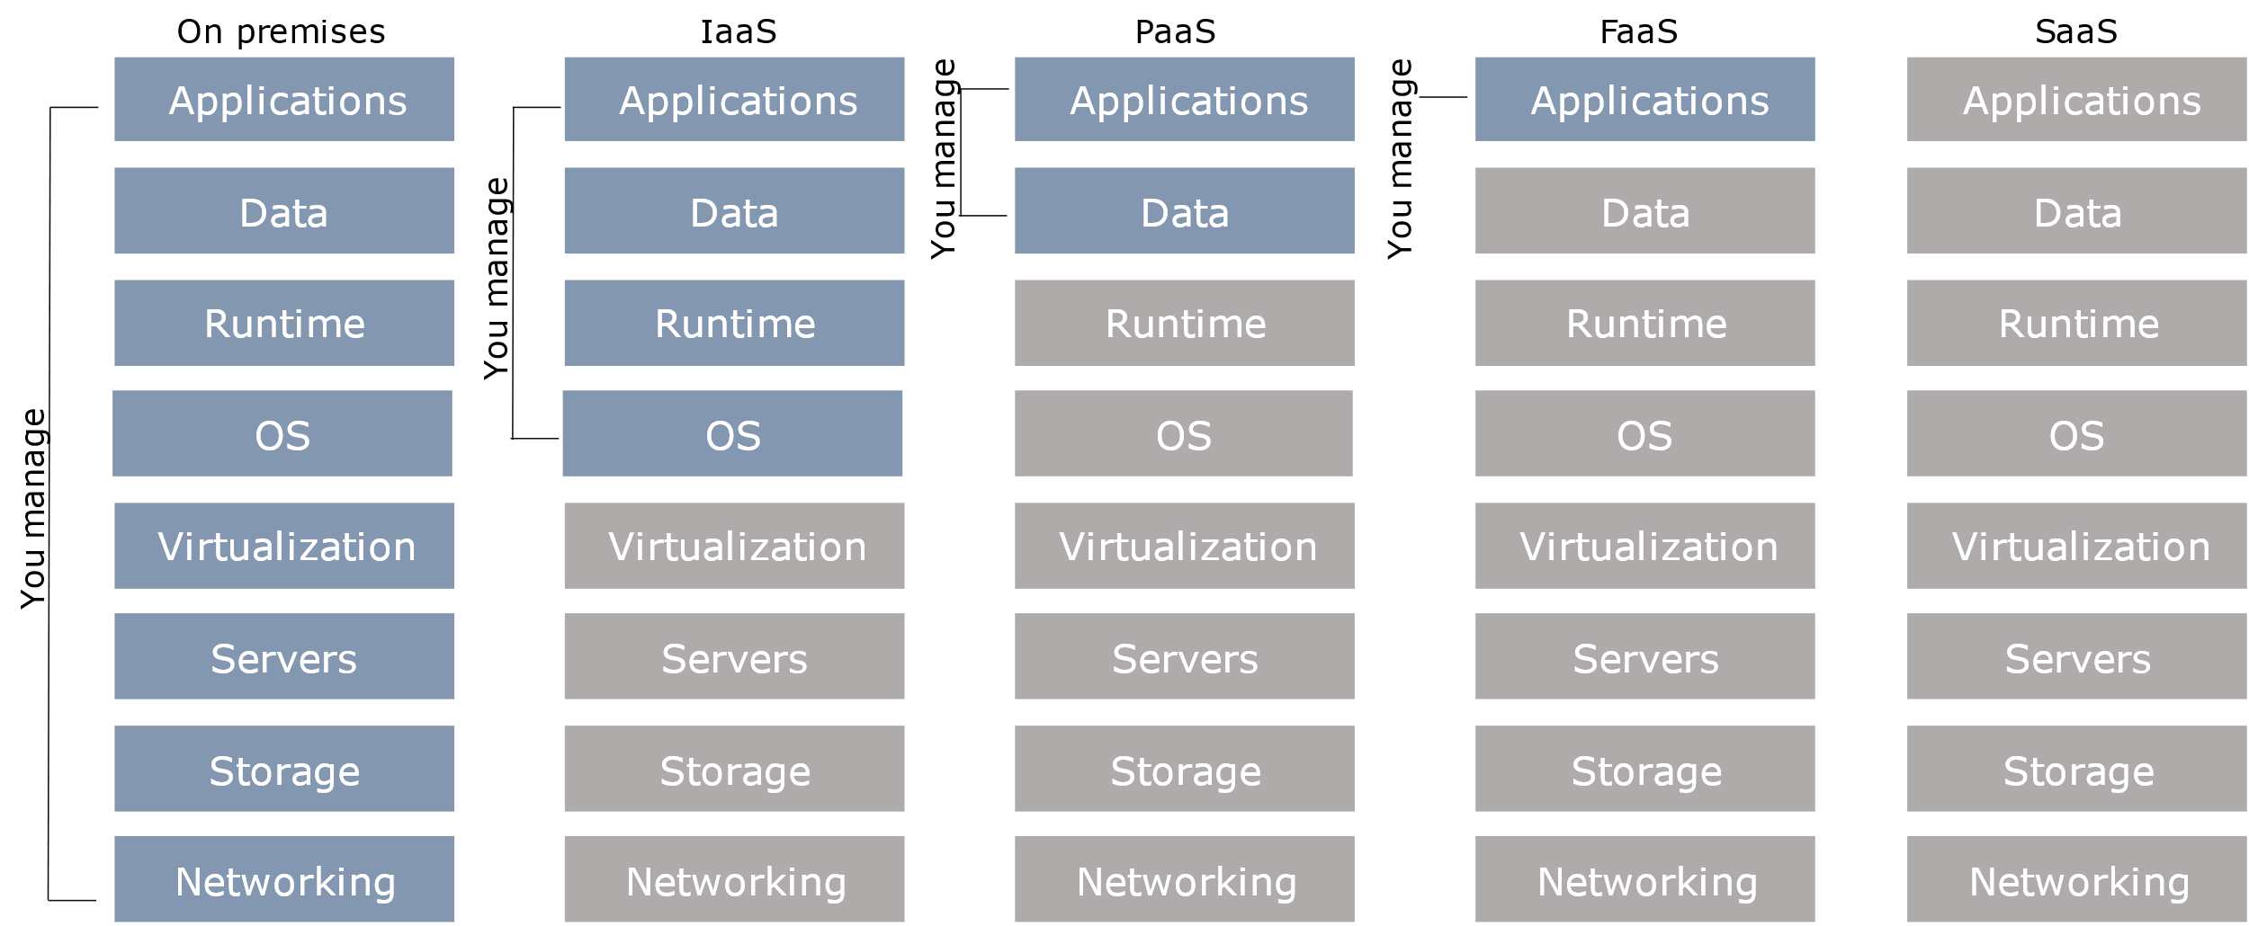
From PaaS to FaaS

Slide 39
From PaaS to FaaS
Understanding architectures is paramount to successful software systems
Good architectures help to scale
Poor architectures cause issues that necessitate a costly rewrite
On-premises
Provisioning, managing, and patching servers is time-consuming
Require dedicated operations people
A non-trivial environment is hard to set up and operate effectively
Infrastructure and hardware are often a distraction from strategic tasks

Slide 40
From PaaS to FaaS
Infrastructure as a service (IaaS)
A computing infrastructure provisioned and managed over the internet (e.g., AWS EC2)
Avoid expense/complexity of buying/managing physical servers/data-centers
IaaS overcomes issues on-premises
Possibly requires to manage many environments
Platform as a Service (PaaS)
A development and deployment environment in the cloud (e.g., AWS Elastic Beanstalk)
Support complete application life-cycle: building, testing, deploying, etc.
Avoid expense/complexity of managing licenses and application infrastructure

Slide 41
From PaaS to FaaS
PaaS and containers are potential solutions to inconsistent infrastructures
PaaS provides a platform for users to run their software
Developers write software targeting features/capabilities of the platform
Containerization isolates an application with its own environment
Lightweight alternative to full virtualization
Containers are isolated but need to be deployed to (public/private) server
Excellent solution when dependencies are in play
Housekeeping challenges and complexities

Slide 42

From PaaS to FaaS
Containers and virtual machines are packaged computing environments
Containers
On top of physical server and its host OS
Share the host OS kernel
Shared components are read-only
Containers are “light” and take just seconds to start
Virtual machines
Emulate a hardware/software system
On top of a hypervisor (VM monitor)

Slide 43
From PaaS to FaaS
Function as a Service (FaaS)
A coding environment, cloud provider provisions platform to run the code (e.g., AWS Lambda)
Infrastructure provisioning and management are invisible to the developer
Software as a service (SaaS)
An application environment
Access cloud-based apps over the Internet (e.g., email, Microsoft Office 365)

Slide 44
From PaaS to FaaS
Serverless
A software architecture that does not rely on direct access to a server
Embodies principles from microservices
Small, standalone, fully independent services built for a specific purpose
Cloud provider is responsible for integration
Principles of FaaS architectures
FaaS is based on a serverless approach
Use a compute service to execute code on demand (no servers/containers)
Every function could be considered as a standalone service
Write single-purpose stateless functions

Slide 45
From PaaS to FaaS
Functions react to events
Design push-based, event-driven pipelines
Create thicker, more powerful front ends
Embrace third-party services (e.g., security)
FaaS is not a silver bullet
Not appropriate for latency-sensitive applications
Strict specific service-level agreements
Migration costs
Vendor lock-in can be an issue

